Slide 1
Aerial Pathfinding Reconnaissance Final Presentation
Jason Gilman, Max Griffith, Mark Johnson, Dilanka Weerasinghe

Slide 2
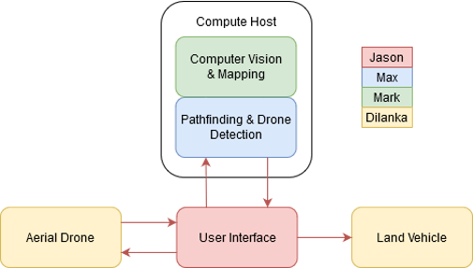
Overview
Goal: Use aerial drone footage to find a safe path for a land vehicle.
Team Members and Responsibilities:
Dilanka Weerasinghe (Data Collection & Drone Control)
Automated drone control and collection of aerial footage
Mark Johnson (Computer Vision & Mapping)
Production of an obstacle map from drone videos
Max Griffith (Pathfinding & Drone Detection)
Determination of vehicle starting location and route
Jason Gilman (Device Networking & UI)
Creation of user interface and network interconnect
System Block Diagram

Slide 3
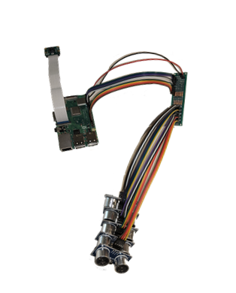
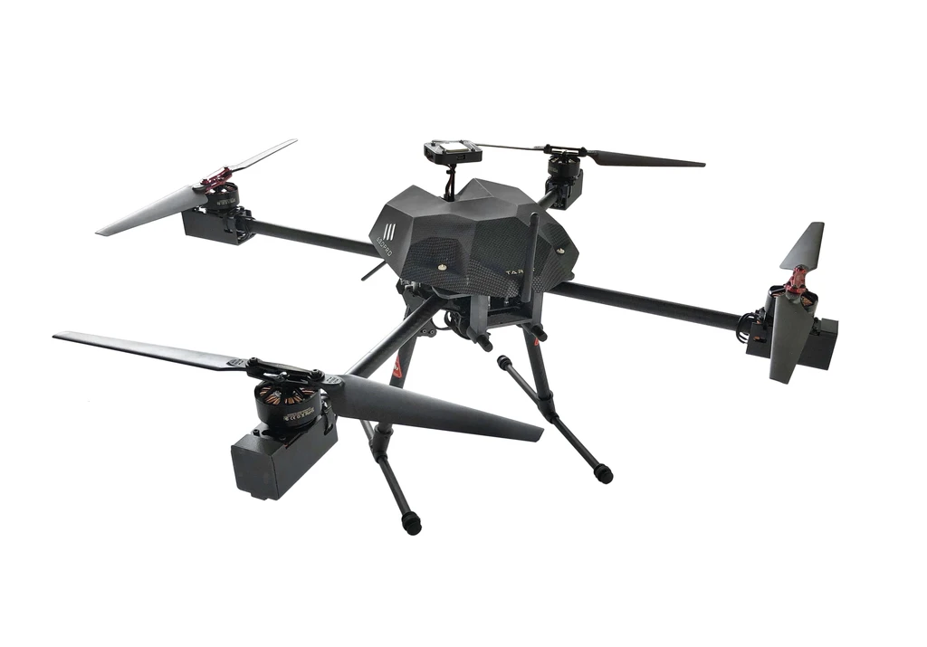

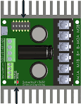
Data Collection & Drone Control
Accomplishments:
Physical Electronics
PiCam records interval video and records to a datasheet with timestamp & GPS location
Avoidance system mounted to Aerial Drone with sensor hub
Land Rover complete with serial connection through Pi3. Not tested.
Simulator
Drone reads in data file with altitude, camera angle yaw and waypoint locations
Drone performs safety check arms and takes flight.
Obstacle avoidance case for GUIDED directions
Loading commands to vehicle through serial/udp connection.
Flight distance, directionality and logging completed.

Slide 4
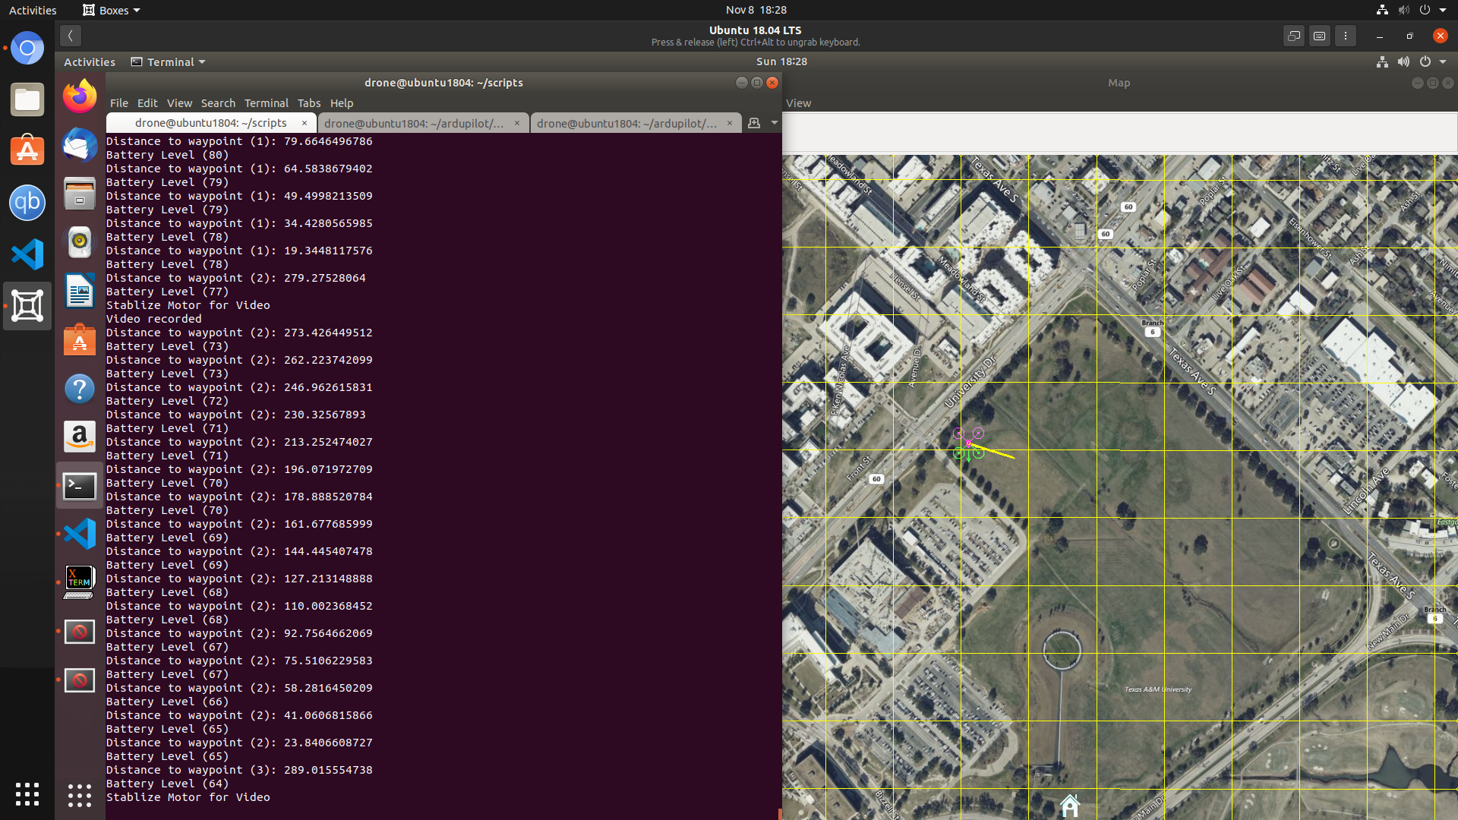
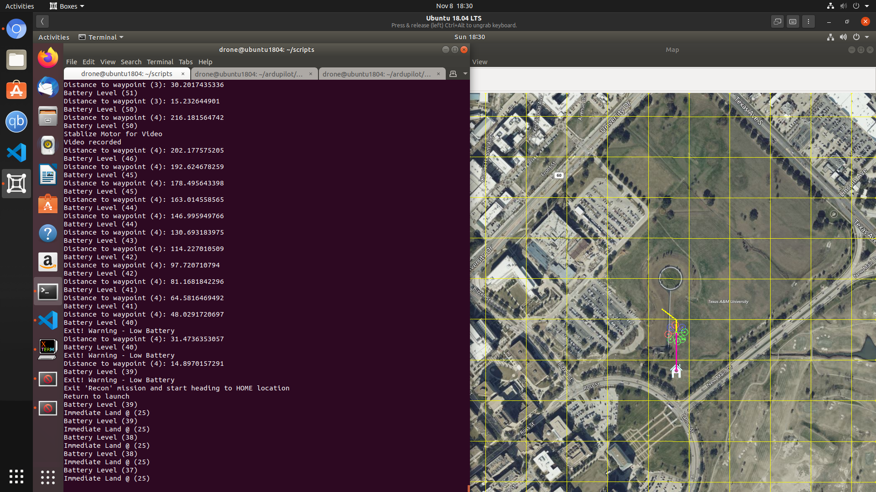
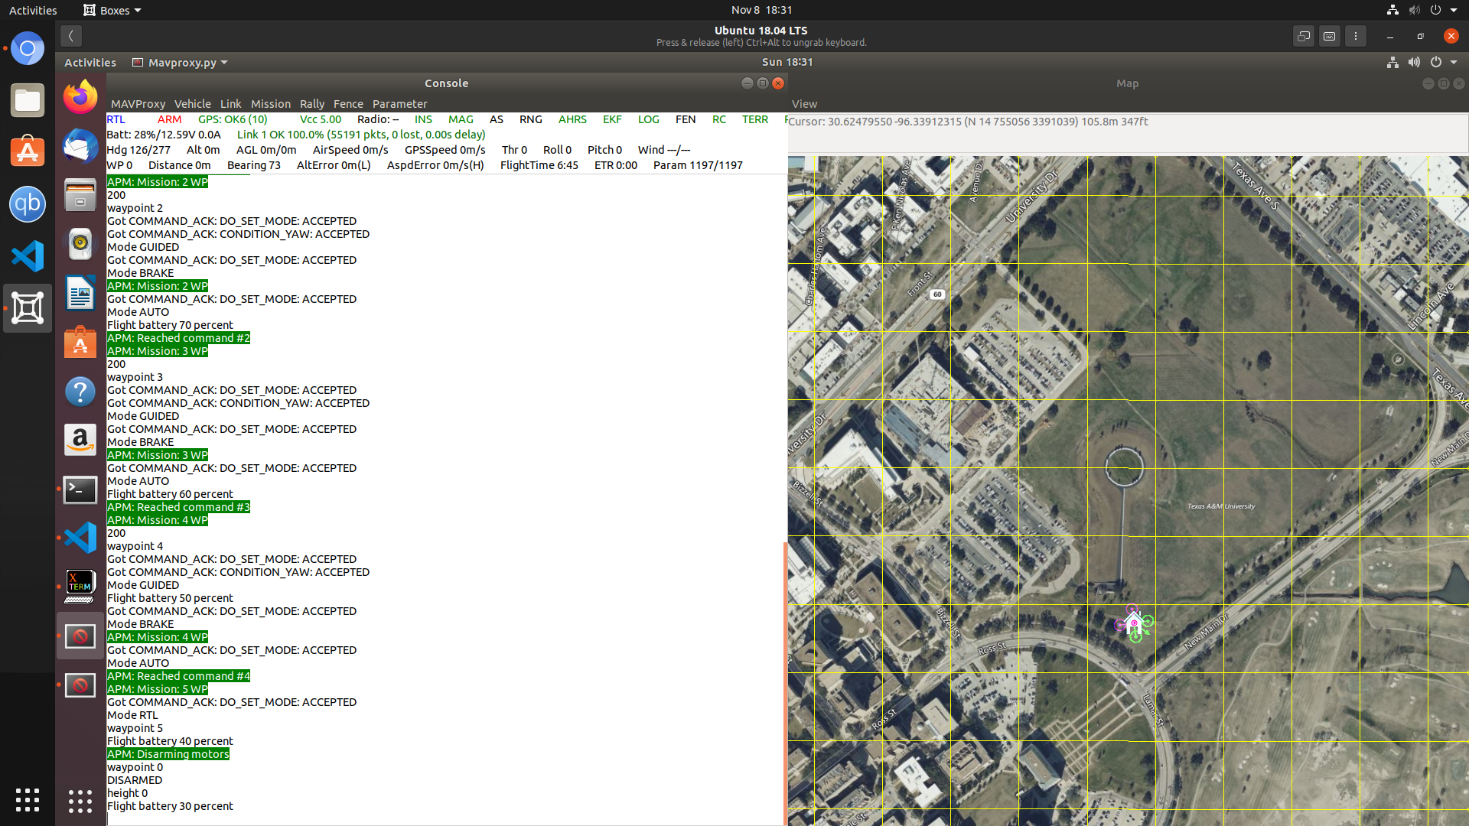
On data collection yaw set to 270̊ , video last 5 seconds
On low battery drone logs warning and returns home. If battery is less than 25% land immediately.
Commands sent to PixHawk running ArduCopter firmware.

Slide 5
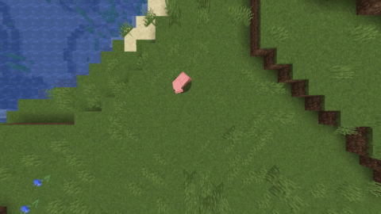
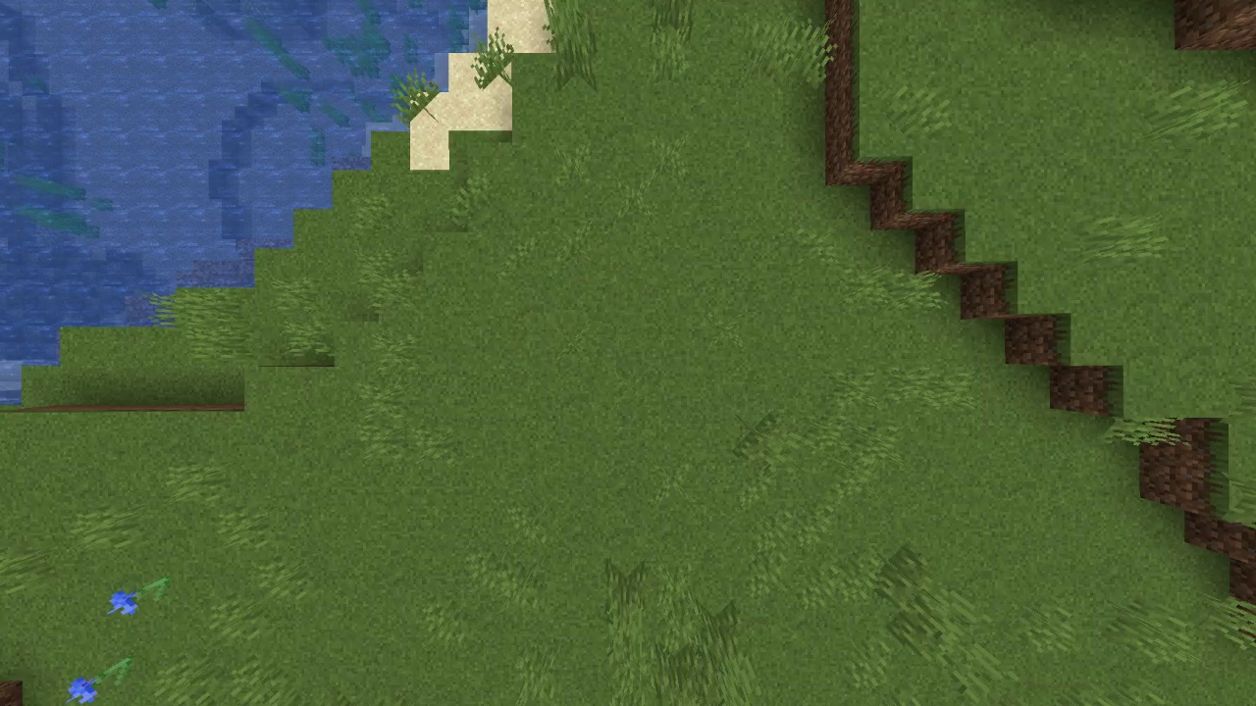
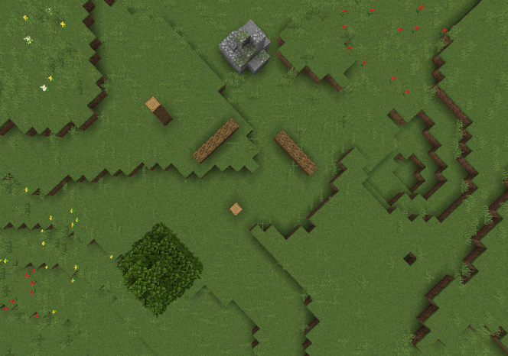
Computer Vision & Mapping
Demo: Moving Object Removal
All stages are complete:
Moving Object Removal
Image Stitching
Poor result due to changing perspective.
Final product will not rely on this feature.
Depth Map Inference
Parameters need tweaking at runtime.
Depth Map Stitching
Custom algorithm developed for this project.
Gradient Field Derivation
Obstacle Delineation
Input Video
Output Image
Demo: Obstacle Detection by Slope Analysis
Input Image (Left Eye View)
Output Obstacle Map

Slide 6
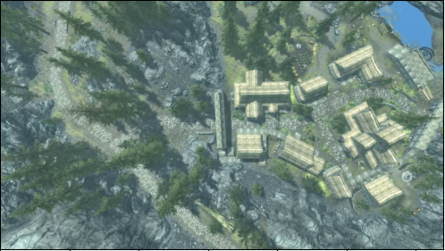
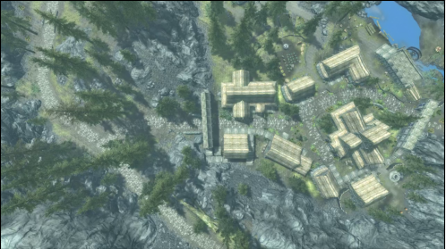
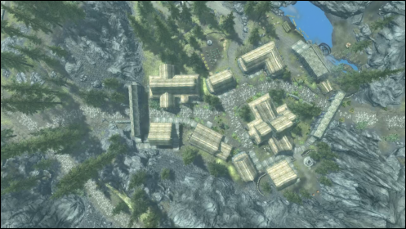
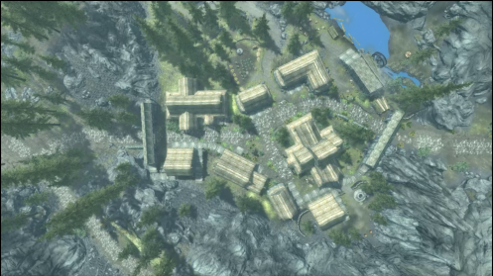
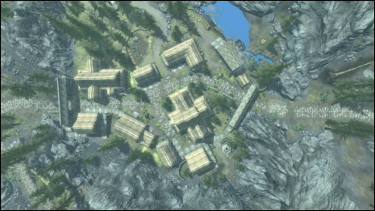
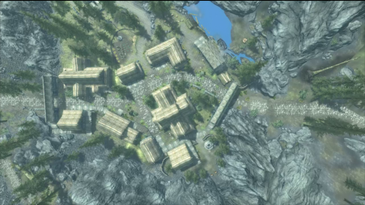
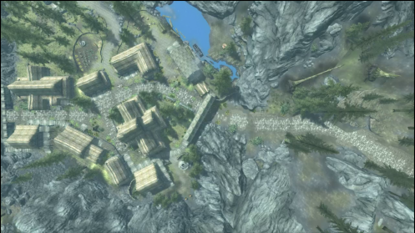
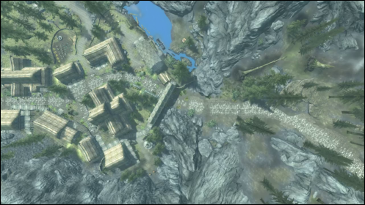

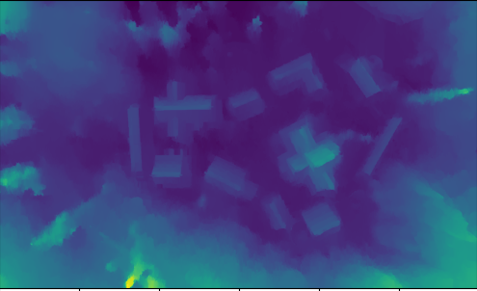
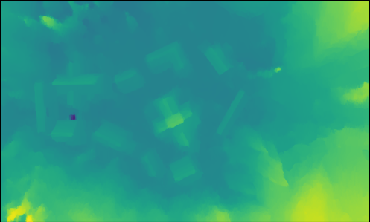


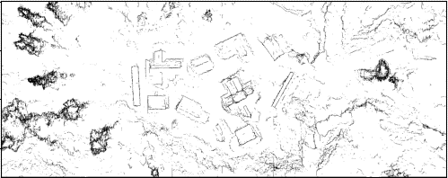
Computer Vision & Mapping Full Pipeline Example
L
R
L
R
L
R
L
R
Stage 1.
Moving Object Removal
Stage 2.
Depth Inference
Stage 3.
Depth Map Merging
Stage 4.
Gradient Derivation & Slope Filtering

Slide 7
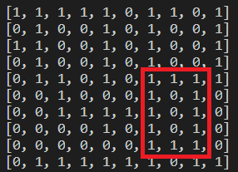
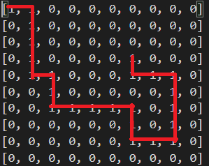
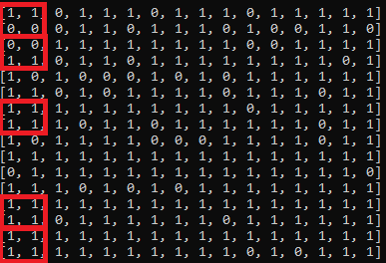
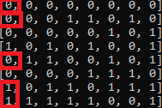
Pathfinding & Drone Detection
Cyclic Path:
Stages Complete:
Finding straightforward path
Working as intended
Paths not taken for final path are marked as invalid (0)
Greedy algorithm taking rightmost one
Edge cases and error handling
Edge cases such as finding cycles have been fixed (infinite loops), improper start/ending positions
Decrease Resolution from a map
Only works with evenly divisible pixel widths
Map with decreased resolution
Cyclic Path Solved*:
Random Generated Map
*The starting location is [0,0] and the ending location is [3,6]

Slide 8
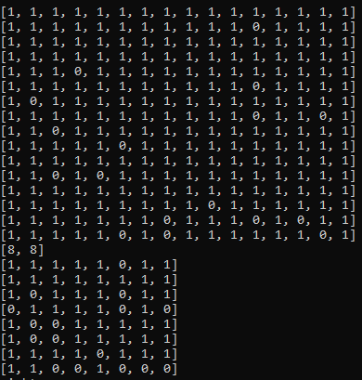
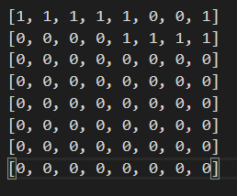
Pathfinding & Drone Detection
Map Resolution decreased to output file
Example
16 by 16 matrix with 2x2 pixels
Minimizes to 8x8
Valid path created
Demo Plans:
Show valid path with edge cases taken care of
Show different resolutions of differently sized maps

Slide 9
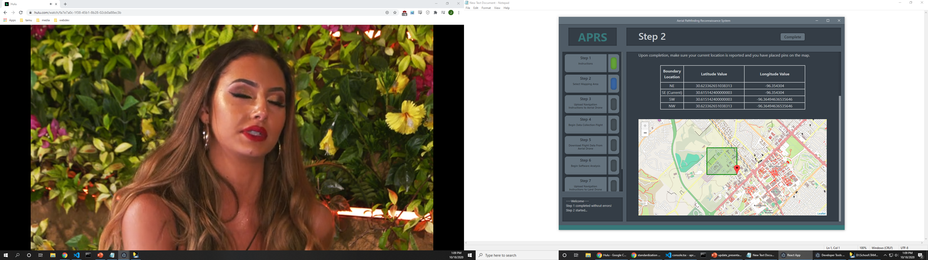
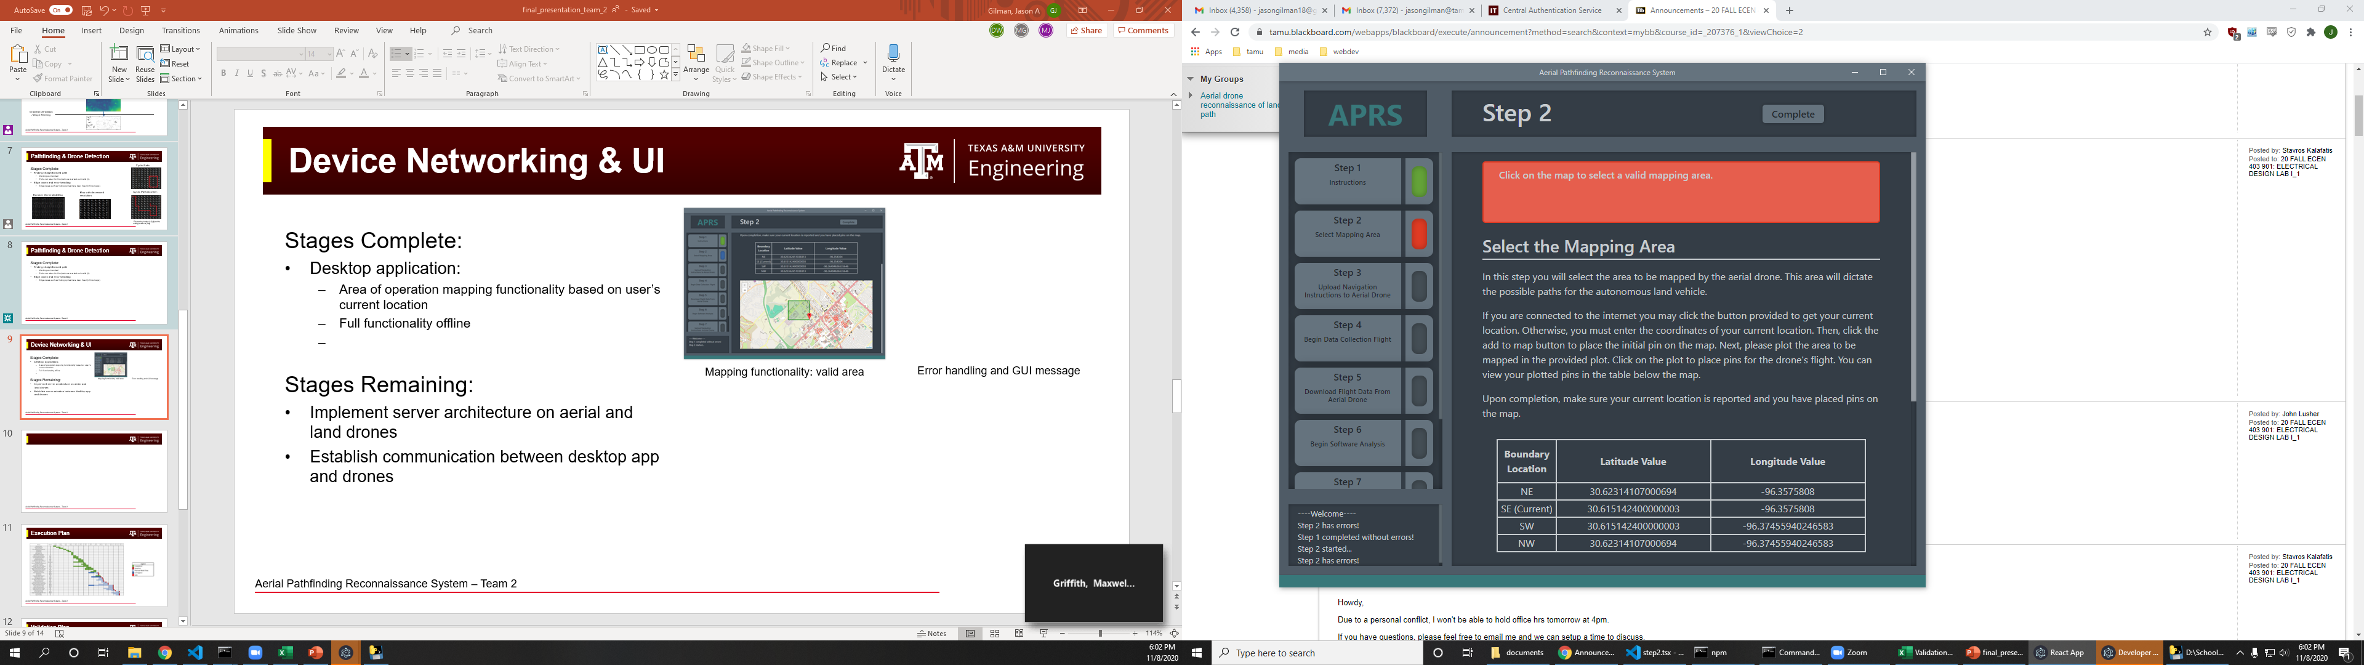
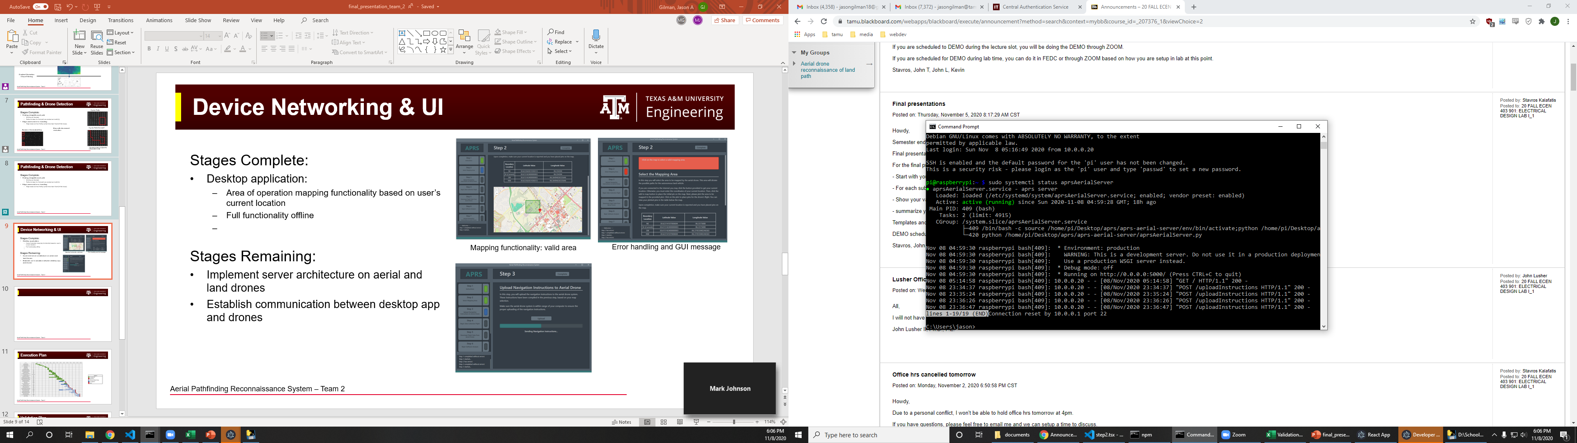
Device Networking & UI
Stages Complete:
Desktop Application:
Mapping functionality based on user’s current location
Generate navigation instructions for the aerial drone
Send navigation instructions, launch flight, and download data from aerial drone through HTTP methods on local wifi network
Error handling to prevent invalid operation
Full functionality offline
Aerial Drone Server:
Raspberry Pi 3b+ acting as a wireless access point using TL-WN722N wireless module (range ~30 m)
Running a lightweight web-server to receive and process communications from the user
Mapping functionality: valid area
Error handling and GUI message
Drone server showing communication with UI

Slide 10
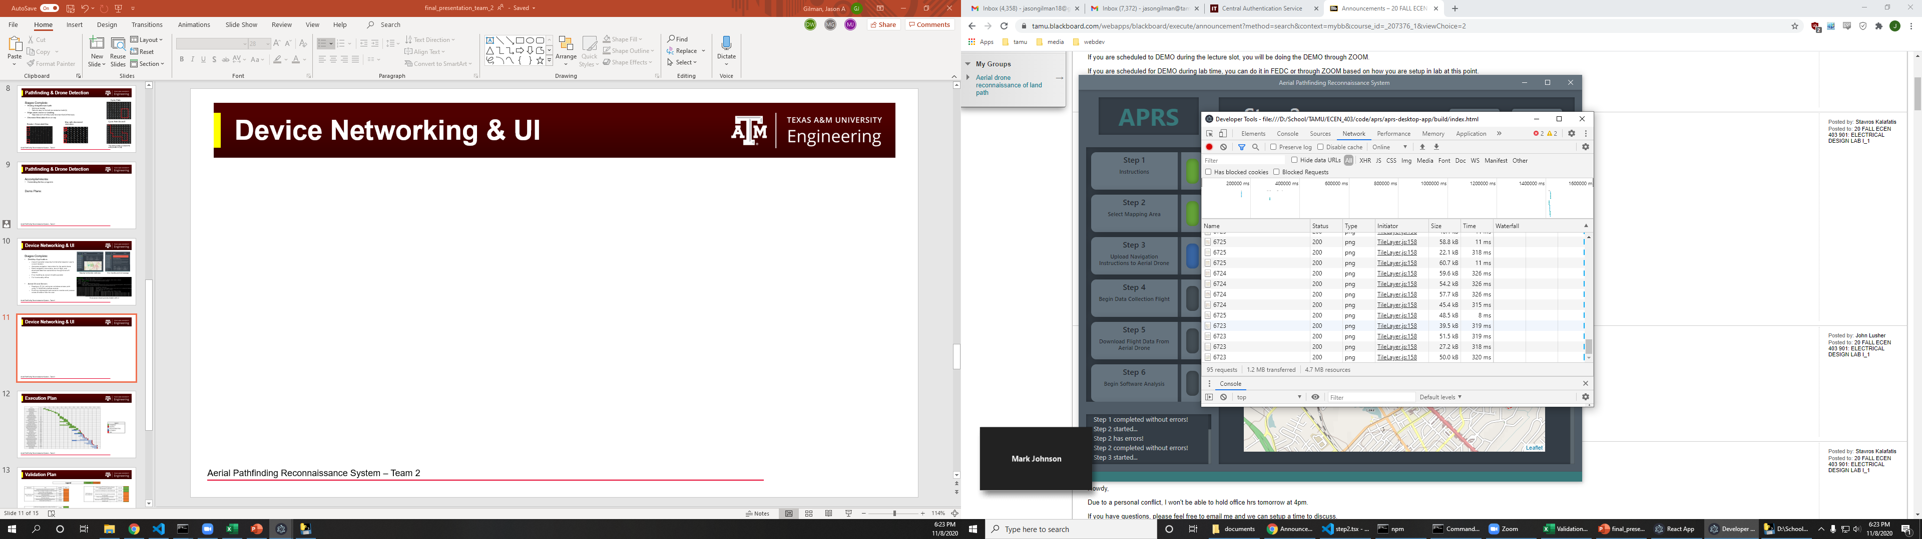
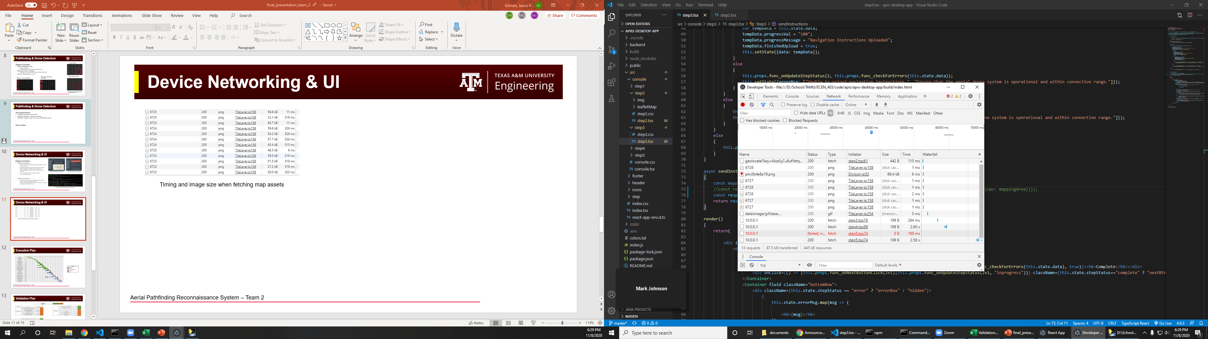
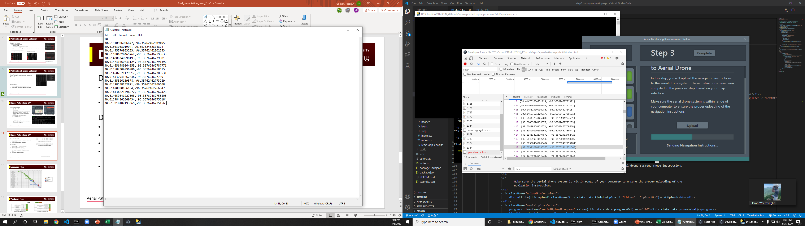
Device Networking & UI
Data Collected:
Communication latency to back-end and drone servers
Aerial drone navigation instructions
Demo Plans:
Walk-through of desktop application
Display offline/online options
Demonstration of mapping utility
Show automated communication to drone server
Show error handling process
Timing and image size when fetching map assets
Timing when communicating with drone server
Generated navigation instructions

Slide 11
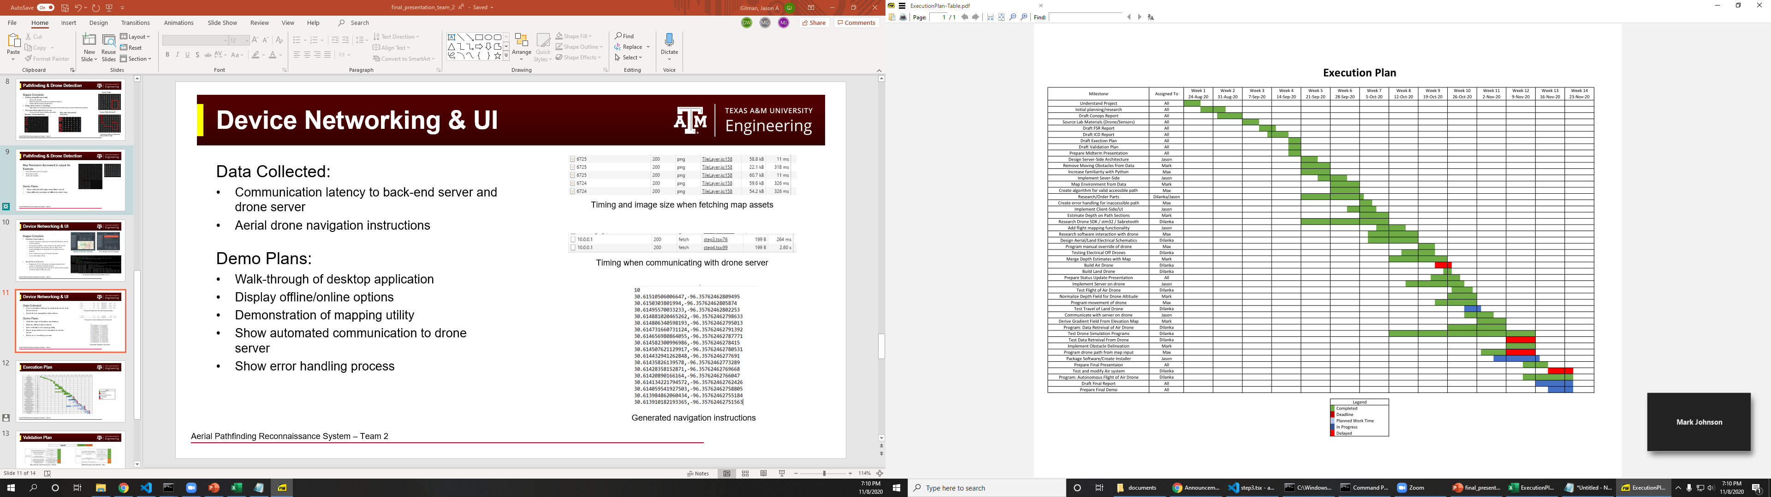
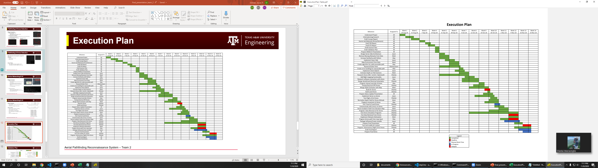
Execution Plan

Slide 12
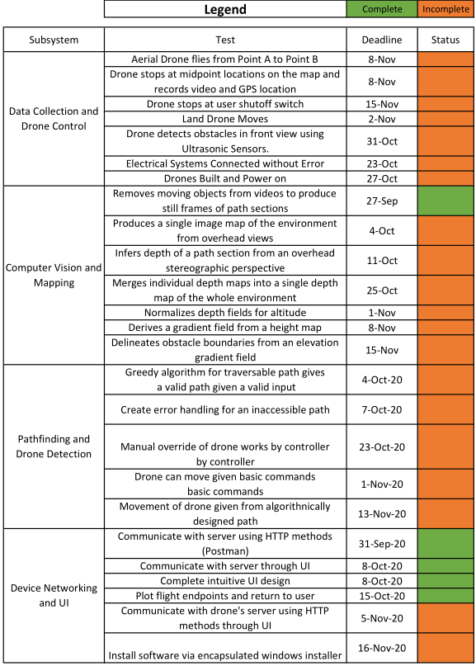
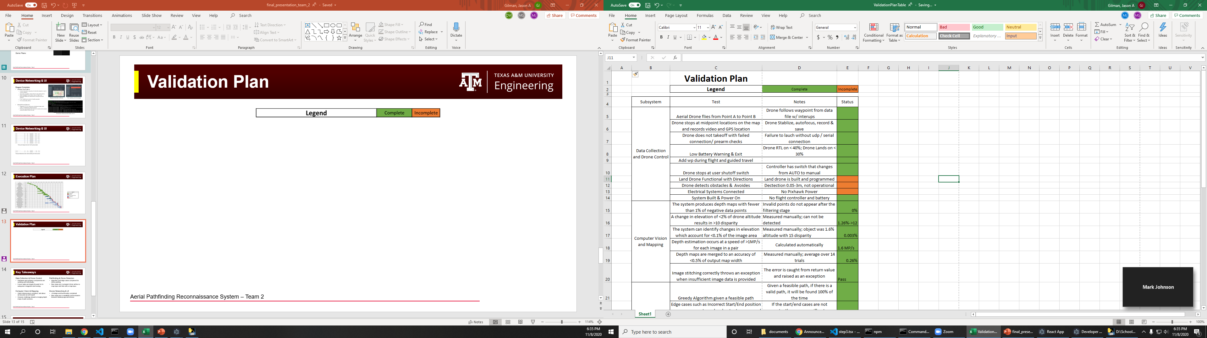
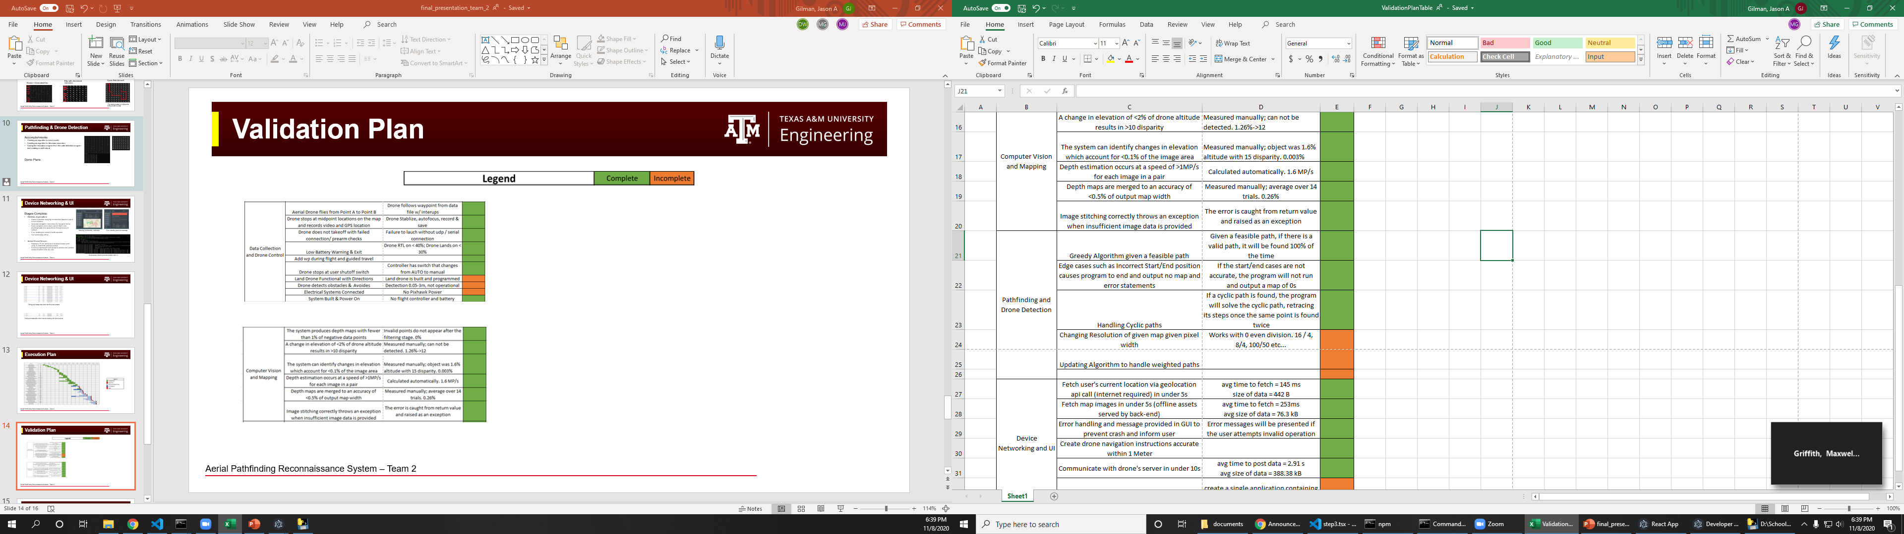
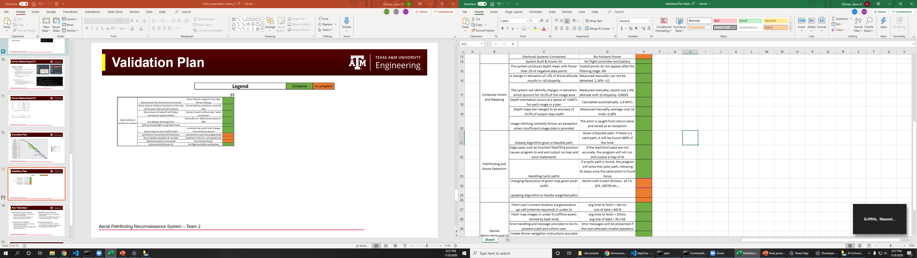
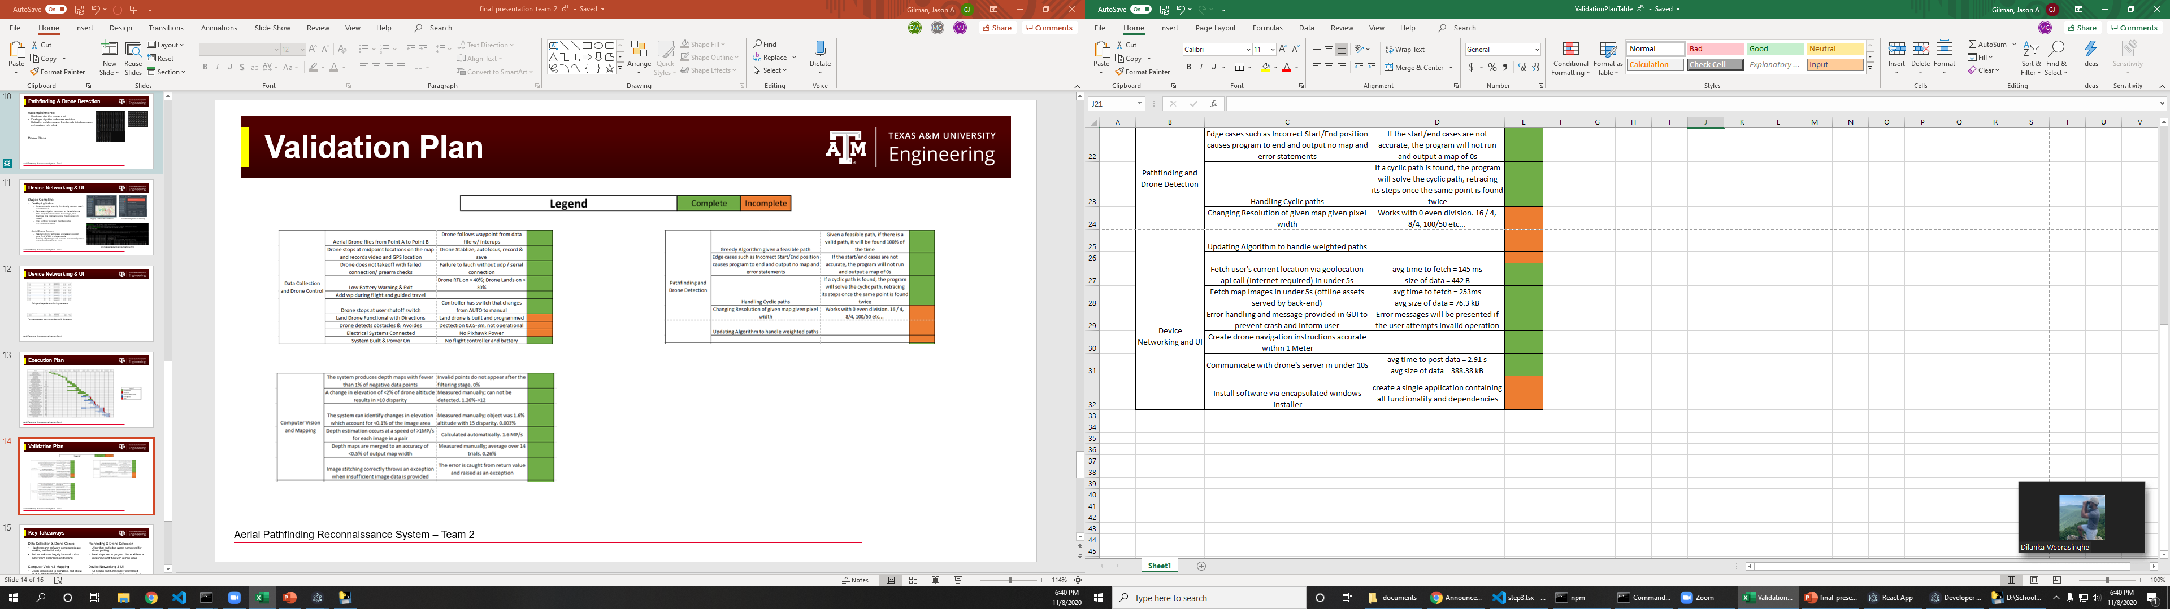
Validation Plan
Data Collection and Drone Control - Dilanka
Pathfinding and Drone Detection - Max
Computer Vision and Mapping - Mark
Device Networking and UI - Jason

Slide 13
Questions?

